Slide 1
CashFlow Creators

Slide 2
Table of contents
Our team
How we managed our time
Our idea
Tech stack

Slide 3
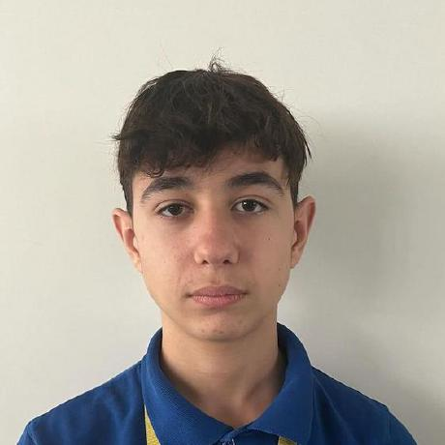
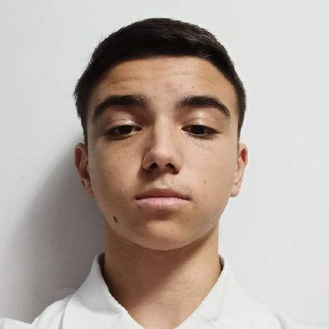
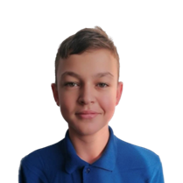
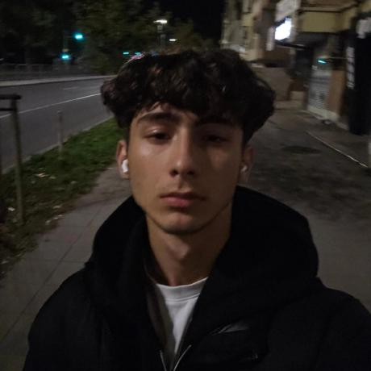
Our team
VBBoyanov
Back-end developer
AGGeorgiev
Back-end developer
AZGeorgiev
Back-end developer
PAAndonov
Scrum trainer

Slide 4
How we managed our time
Gather a team 18.10
Come up with an idea 19.10-20.10
Write the code 21.10-03.11
Do the documentation 03.11

Slide 5

Our idea
Our idea was to create a program to help people with their finance

Slide 6





Tech stack

Slide 7
Lets move on with our project.

